Slide 1
DIFFERENT TYPES OF MATERIALS PRODUCING SOUND

Slide 4
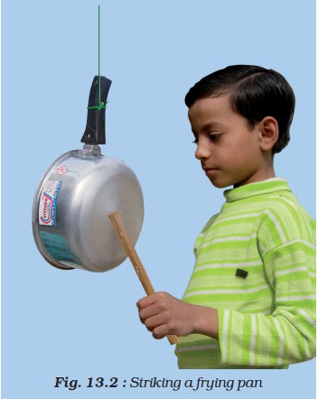
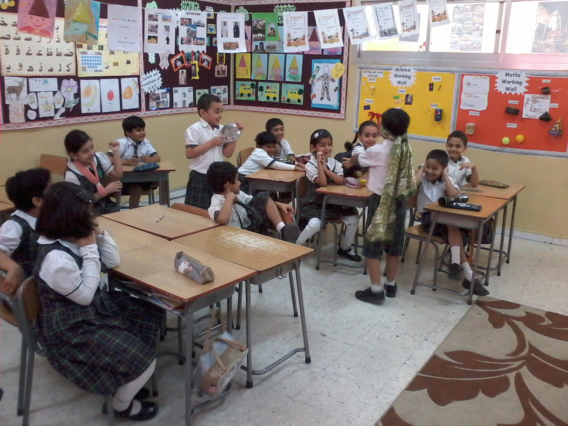

Slide 5
